Slide 1
CEF440: Internet and mobile programming
UI DESIGN AND IMPLEMENTATION OF MARKET MANAGEMENT SYSTEM
GROUP II PRESENTATION

Slide 2
GROUP MEMBERS
NAME | MATRICULE
ETOH KIERA EKUTY | FE20A035
GWANA JUSLINE AKAH | FE20A047
LASSI FOKOU BERICE JILDO | FE20A054
YUVEN BRIAN | FE20A125
AJONG NTI MAGCELOUS | FE20A006

Slide 3
PART ONE
The Design process
PART TWO
The implementation of designs

Slide 4
Design process
PART ONE
The design process began with a thorough analysis of the requirements of the market management system. This involved identifying the key features that the system needed to have, such as product listing, product search, location and price ranges. Once these features were identified, the design team began working on creating the UI Design of the system.
The UI was created using Figma

Slide 5
Figma designs
The various interfaces implemented are
Find product
seller profile
KYC verification of seller
Admin Dashboard
Admin-seller verification
Amin-product review
Login Page
Search Product
Add A new Store

Slide 6
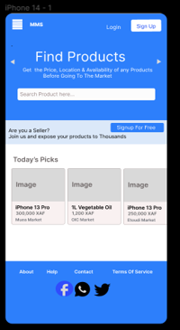
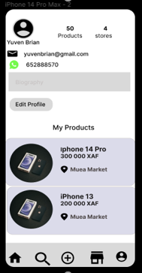
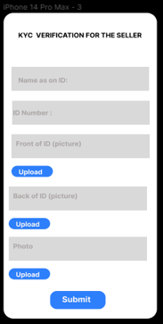
Figma designs

Slide 7
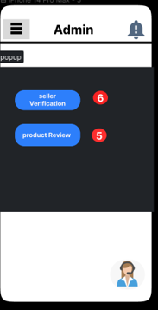
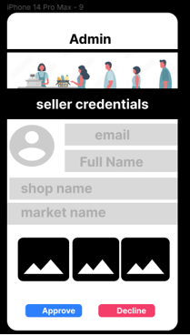
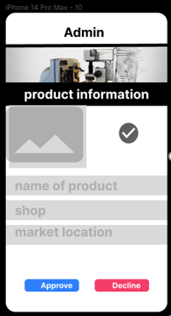
Figma designs

Slide 8
Implementation of designs
The final implementation of the UI was based on the designs created during the design process. The UI was designed to be intuitive and easy to use, with a focus on functionality and usability.
The final implementation of the UI was done using HTML, CSS, and JavaScript. The team used the Bootstrap framework to create a responsive and dynamic UI.

Slide 9
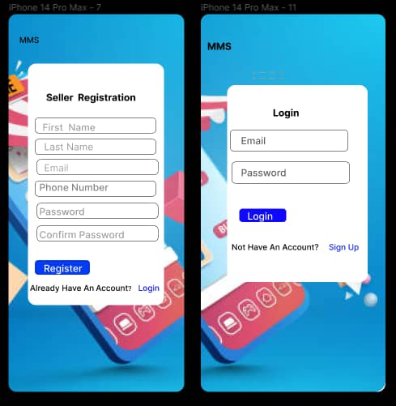
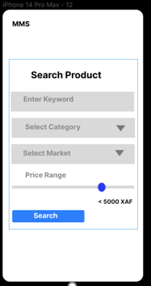

Slide 10
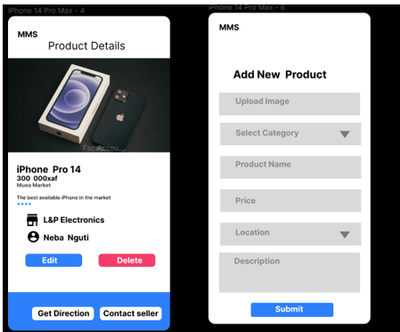
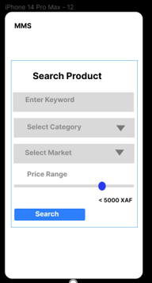

Slide 11
Conclusion
Overall, the design and implementation of UI for a market management system has been a success. The pages created using Figma have been crafted to meet the needs of both buyers and sellers. carefully From the landing page to the search product page, each page has been designed with the user in mind, providing a seamless and intuitive experience

